Slide 1
Analysis of Cryptocurrency Time Series Data

Slide 2
Purpose
A cryptocurrency is a digital asset designed to work as a medium of exchange that uses cryptography to secure its transactions, to control the creation of additional units, and to verify the transfer of assets. Cryptocurrencies use decentralized control as opposed to centralized electronic money and central banking systems.

Slide 3
What gives cryptocurrencies value?
Scarcity
Capped at 21 million
Utility
Advatage of e-commerce, free from regulation
Supply and Demand
Growing popularity

Slide 4
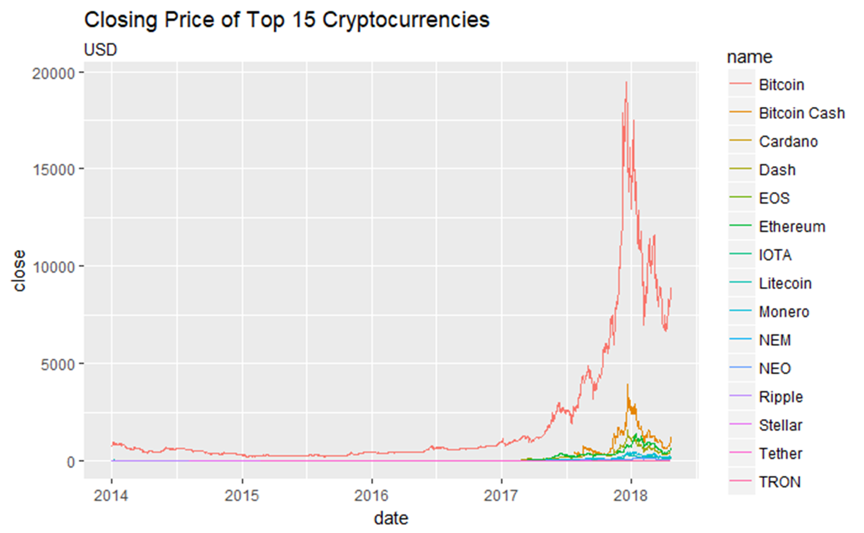

Slide 5
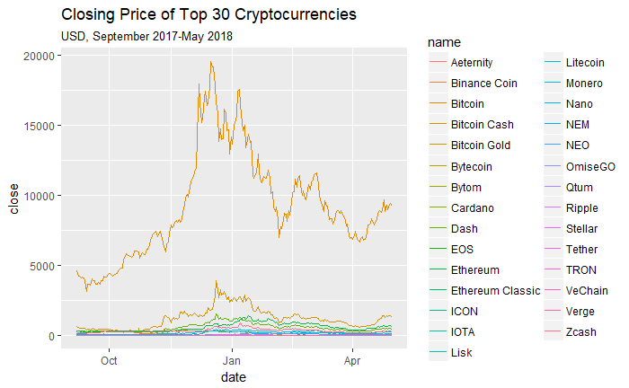

Slide 6
Midterm
Hypothesis One: Are the local peaks of these top cryptocurrencies similar in any way?
Hypothesis Two: are mentions of bitcoin in news media on twitter and price of bitcoin related?
Hypothesis Three: are mentions of bitcoin by the public related to market value of bitcoin?
Hypothesis Four: Is there a time of year that bitcoin value is generally high?
Hypothesis Five: Is there a relationship between number of bitcoin transactions and its market value?

Slide 8
Disclaimer
Cryptocurrency prices are not decided by one central authority, but are set by the exchange where trading is taking place.
Indexes, are aggregates of different exchanges and are what are often cited by news media.

Slide 9
Data
The majority of my data concerning cryptocurrency prices comes from the “cryptoR” package.
Retrieves all the open, high, low, close values for all cryptocurrencies. This retrieves data from CoinMarketCap's historical prices, exchange details and current prices API.

Slide 10
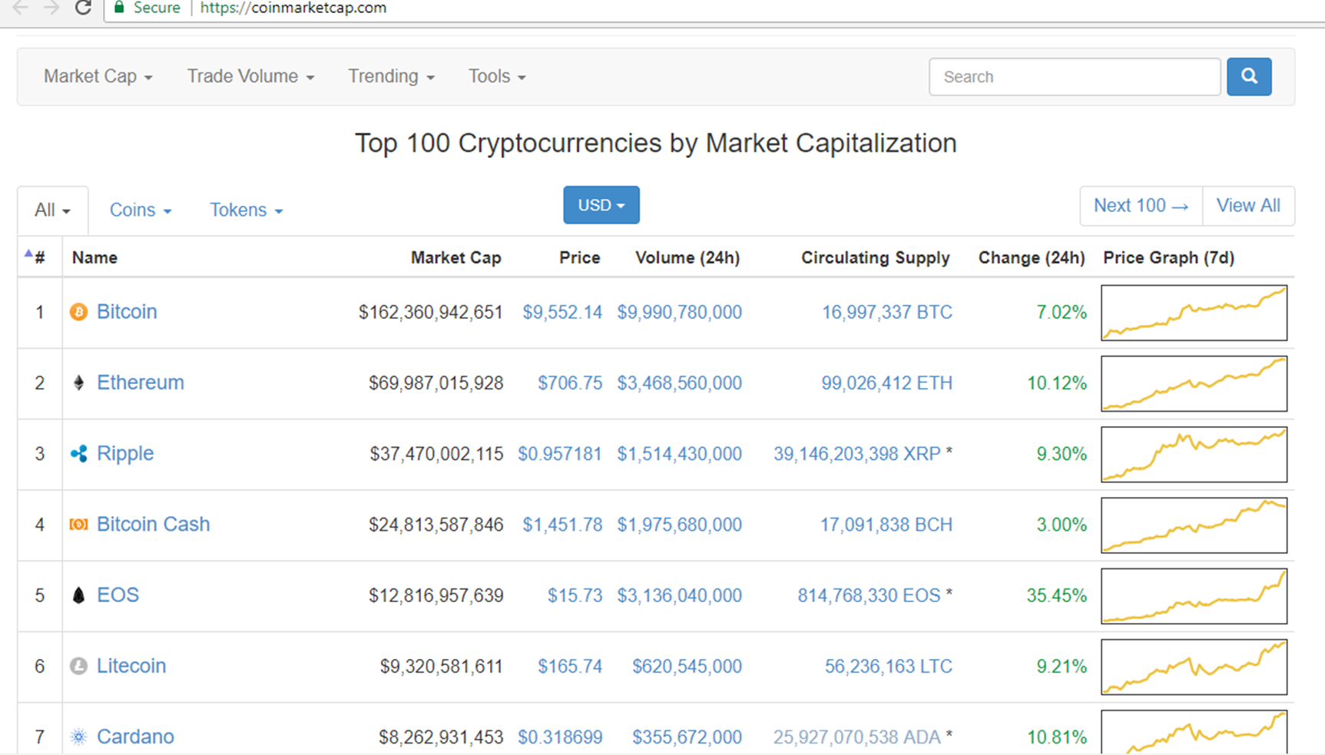

Slide 11
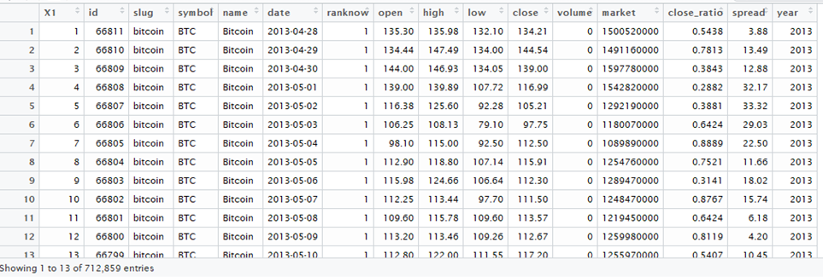
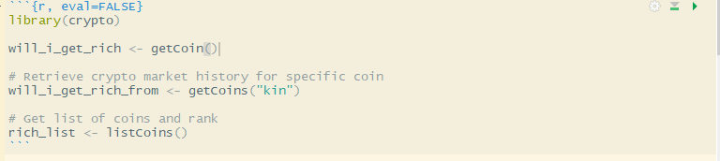

Slide 12
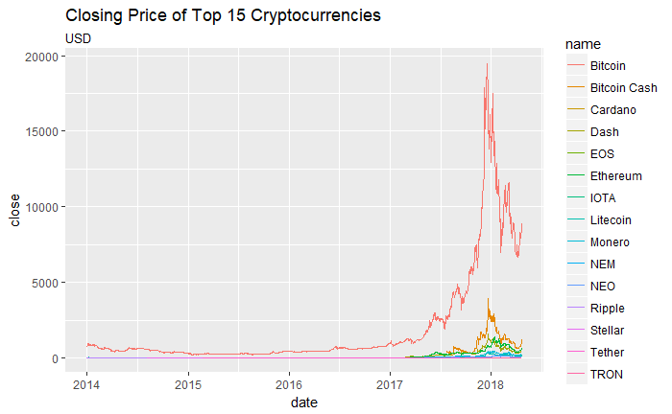

Slide 13
What makes cryptocurrencies volatile assets?
Regulation
Market fluctuations
Try to find out what

Slide 14
Hypothesis Two: are mentions of bitcoin in news media on twitter and price of bitcoin related?

Slide 15
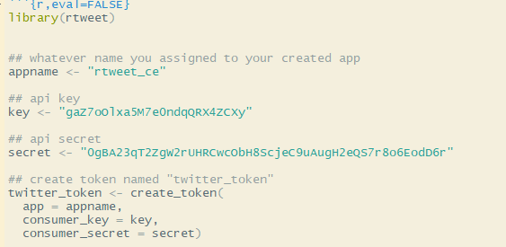

Slide 16
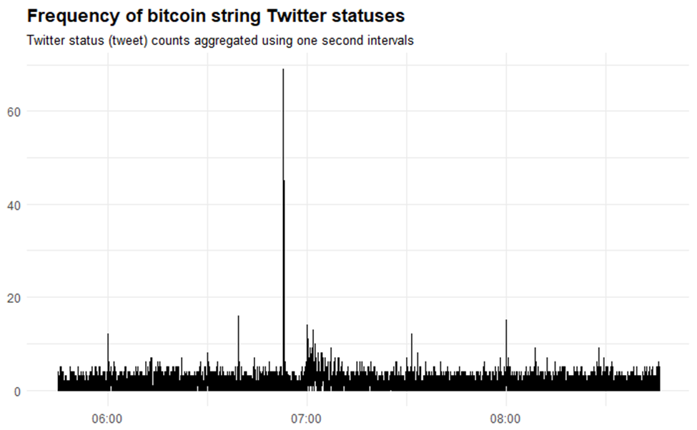
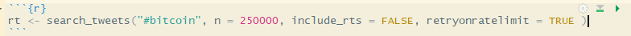

Slide 17
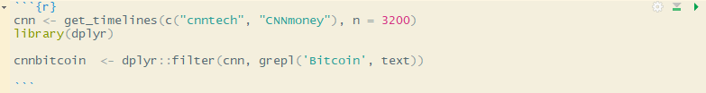

Slide 18
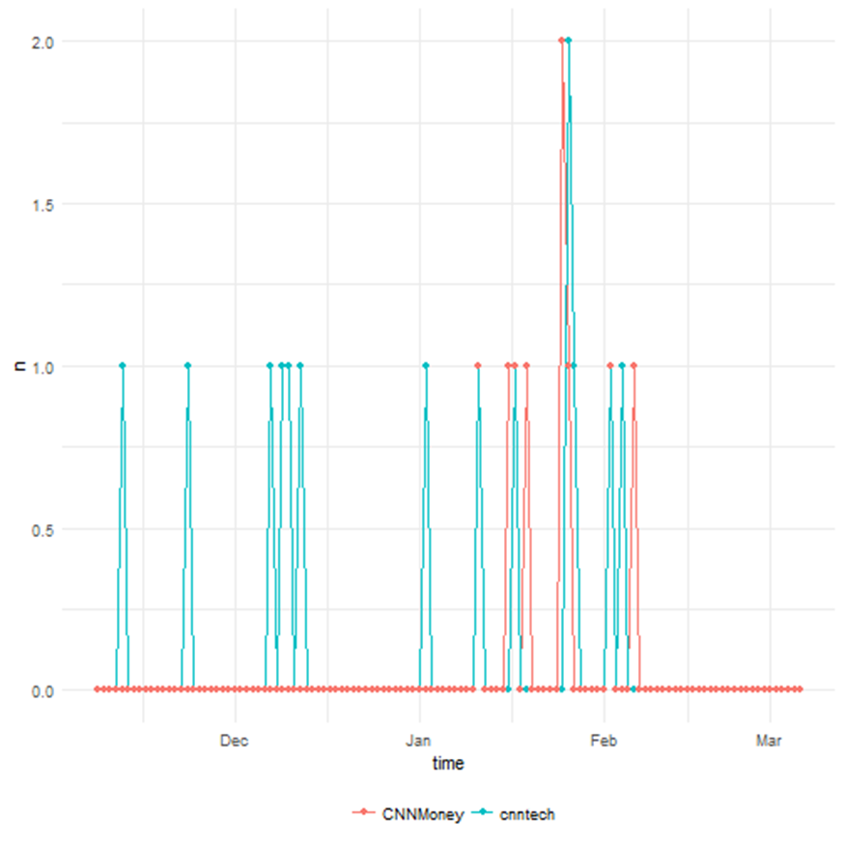

Slide 19
Expand my Hypotheses….
HYPOTHESIS TWO: ARE MENTIONS OF BITCOIN IN NEWS MEDIA ON TWITTER AND PRICE OF BITCOIN RELATED?
HYPOTHESIS TWO: ARE MENTIONS OF BITCOIN IN NEWS MEDIA AND PRICE OF BITCOIN RELATED?

Slide 20
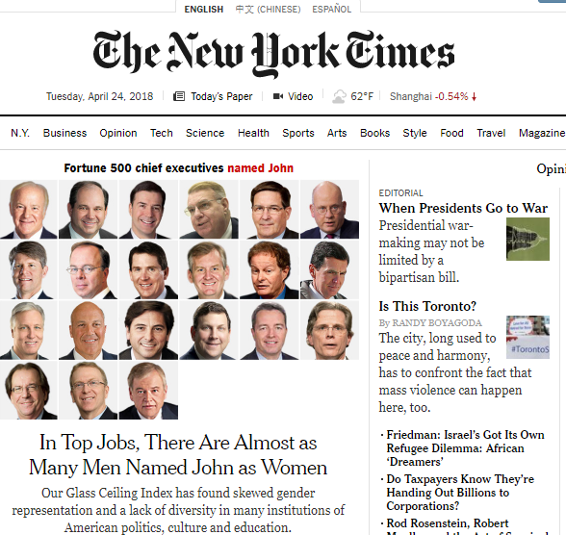
Rtimes
Interface to Congress, Campaign Finance, Article Search, and Geographic 'APIs' from the New York Times

Slide 21
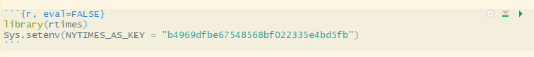
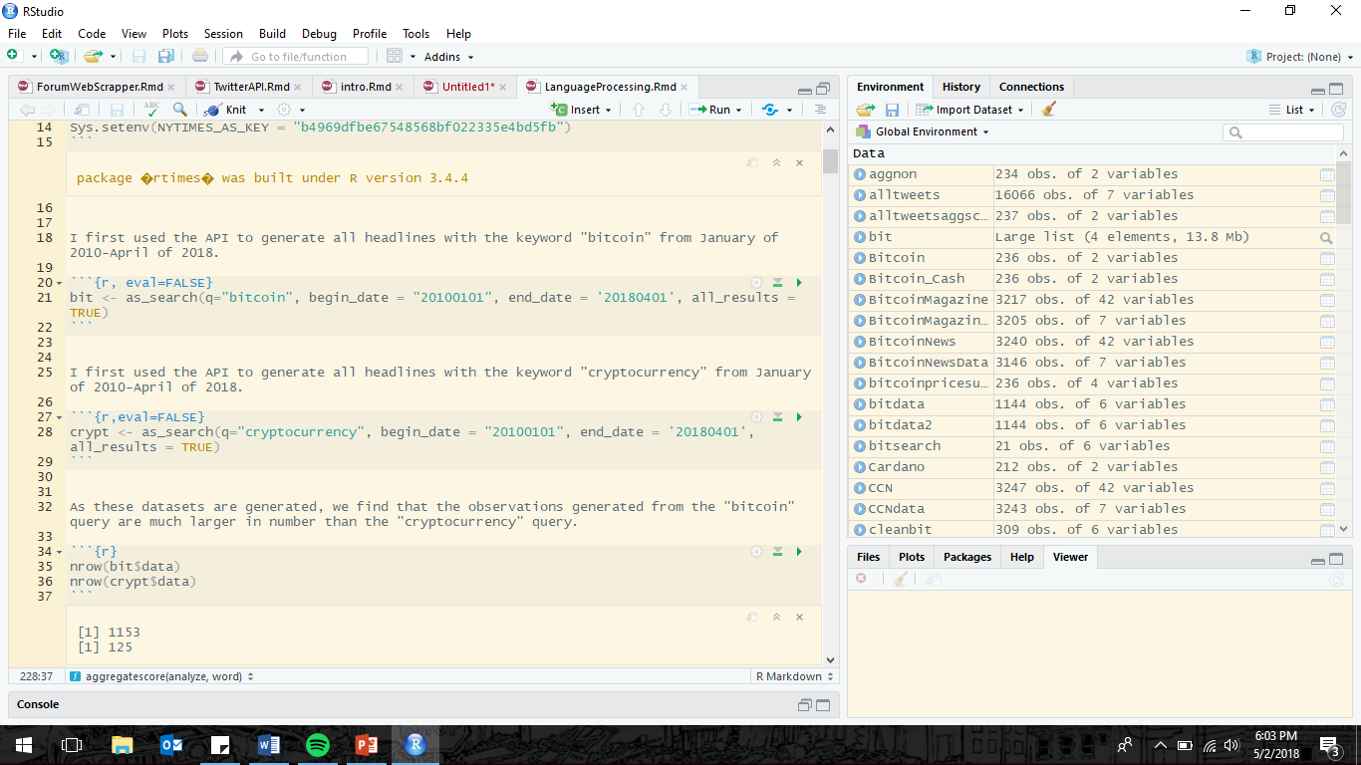

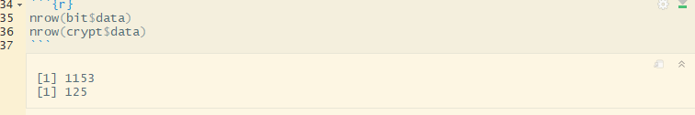

Slide 22
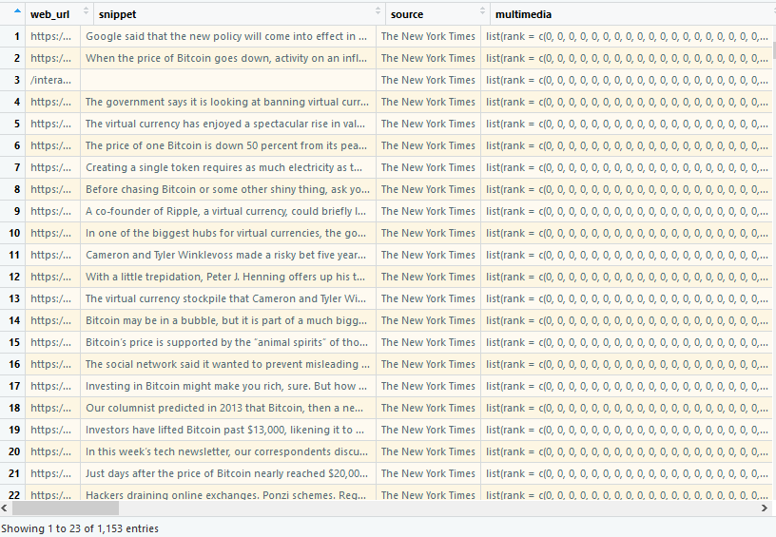
Each query returns a dataframe of 27 variables.
The ones of interest to me are
Headline.main – Headline of Article
Pub_Date-Date of publication

Slide 23
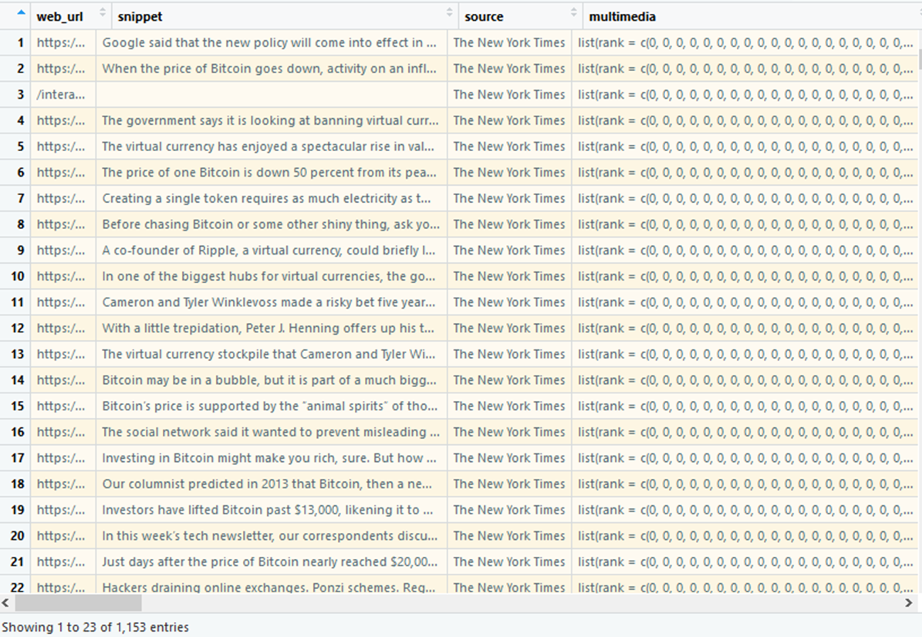
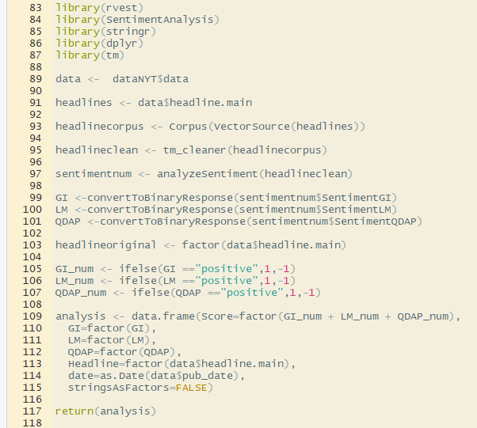
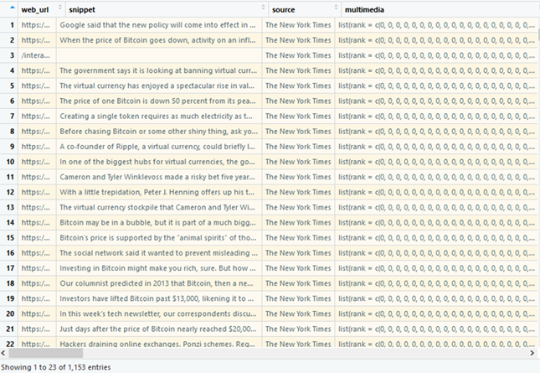

Slide 24
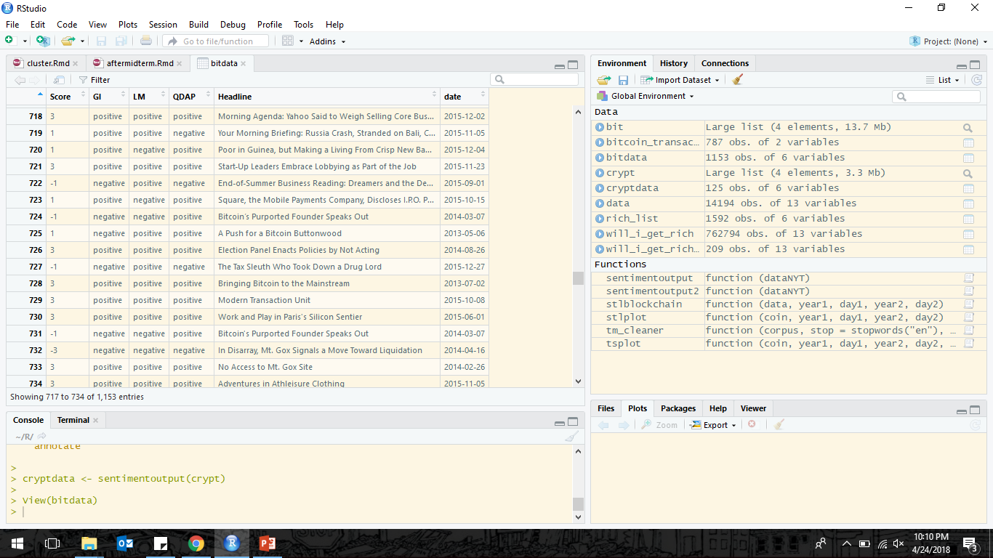
Looking at the data, there are a number of headlines that don’t seem to have much to do with bitcoin or crypto currency. will delete rows if no string of bitcoin and cryptocurrency exist

Slide 25
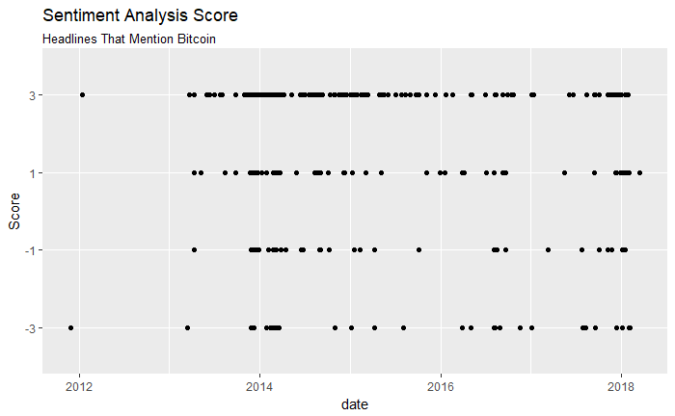

Slide 26
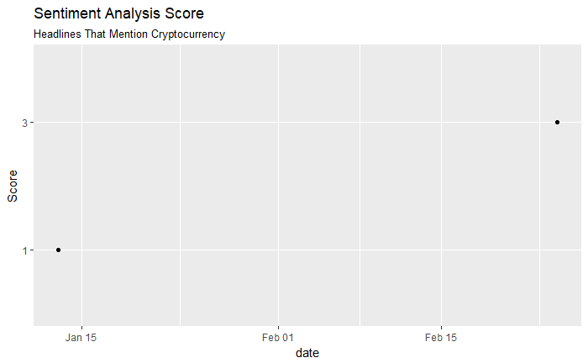

Slide 27
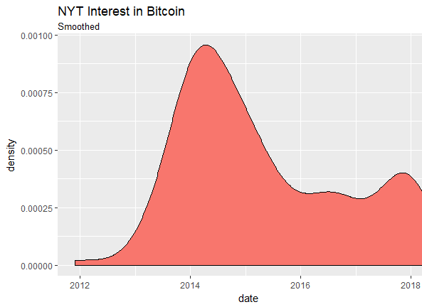

Slide 28
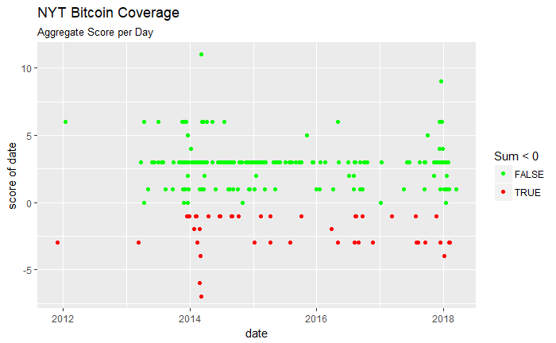

Slide 29
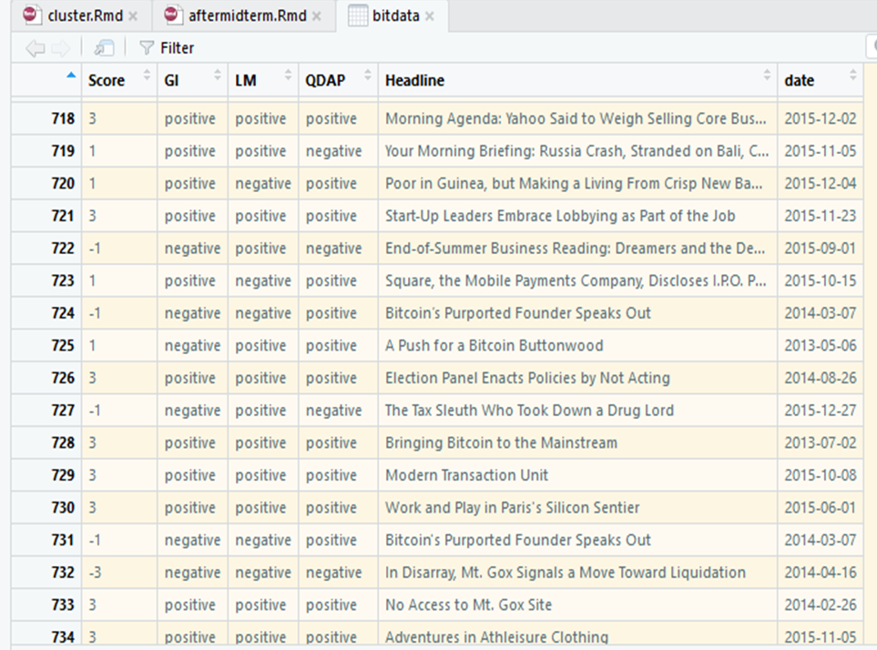
Problem of Bias….
What about more neutral responses?

Slide 30
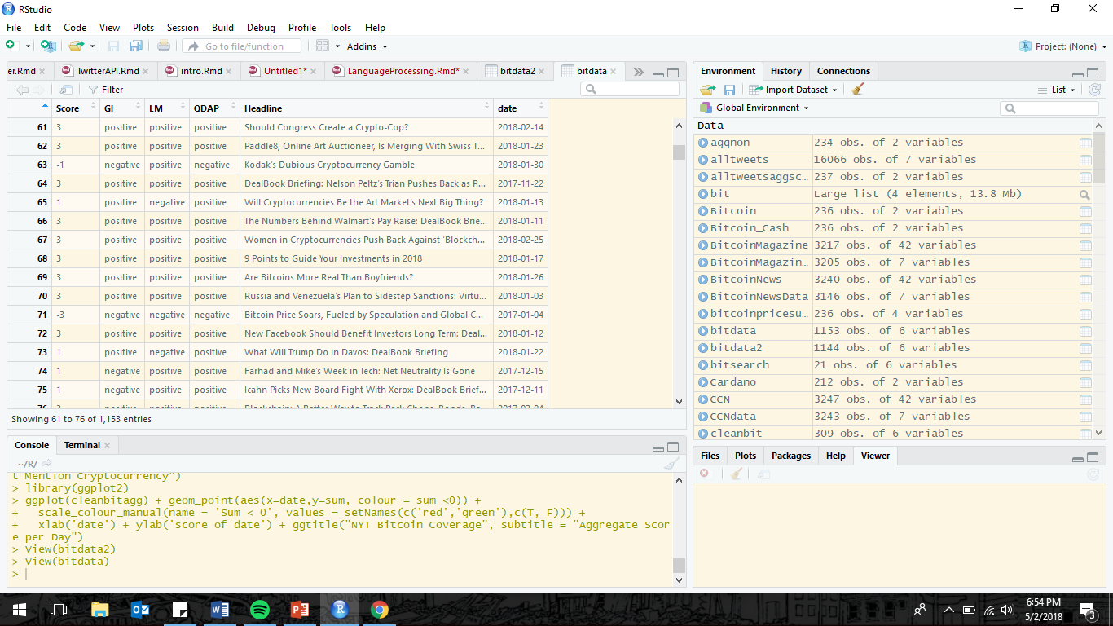
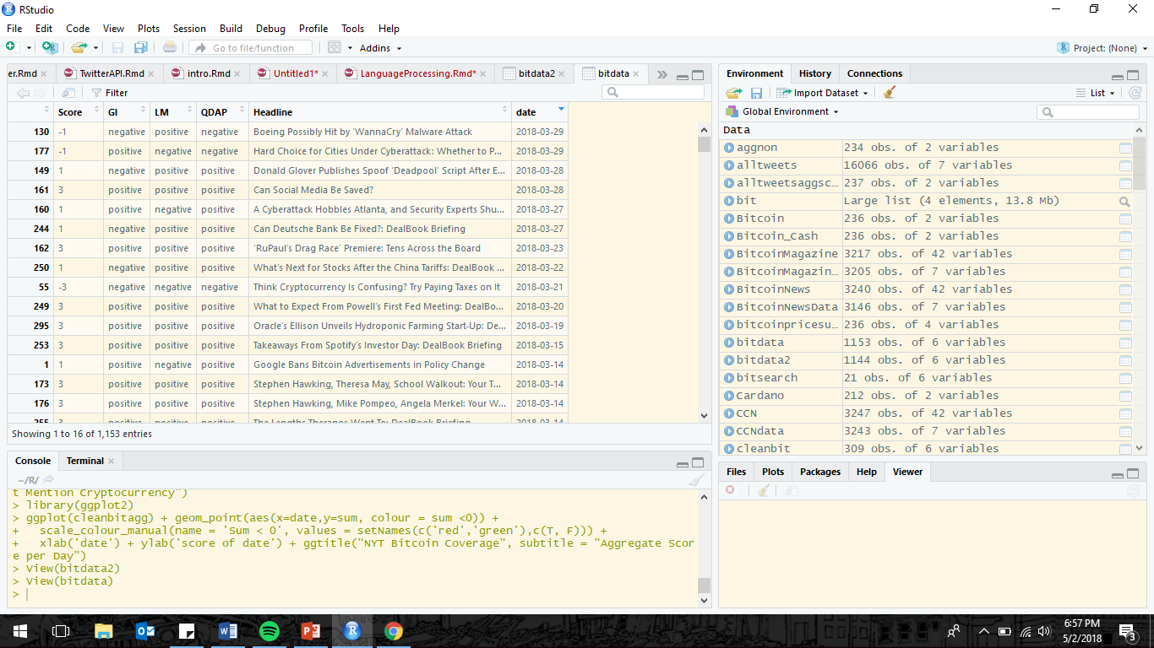
Problem of Bias….
What about more neutral headlines?

Slide 31
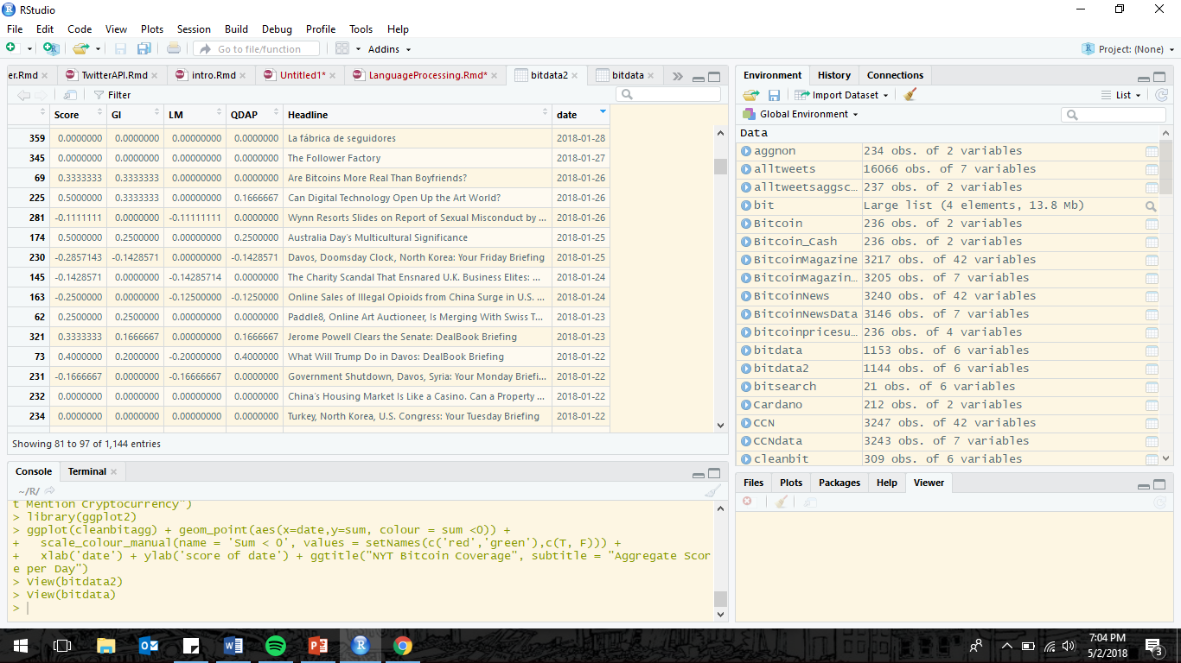

Problem of Bias….

Slide 32
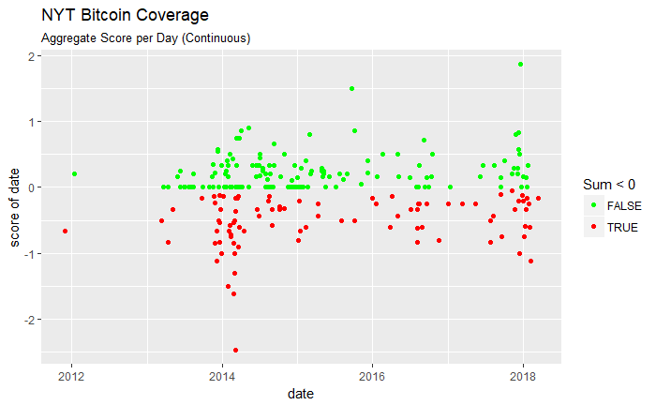
Notes:
Nonbinary score, line 520 USE MAYBE SOME EDIT

Slide 34
What to do now….
Notes:
Nonbinary score, line 520 USE MAYBE SOME EDIT

Slide 35
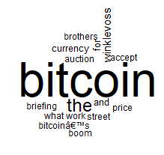
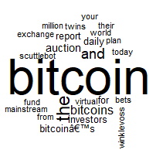
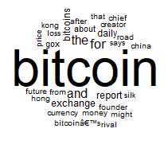
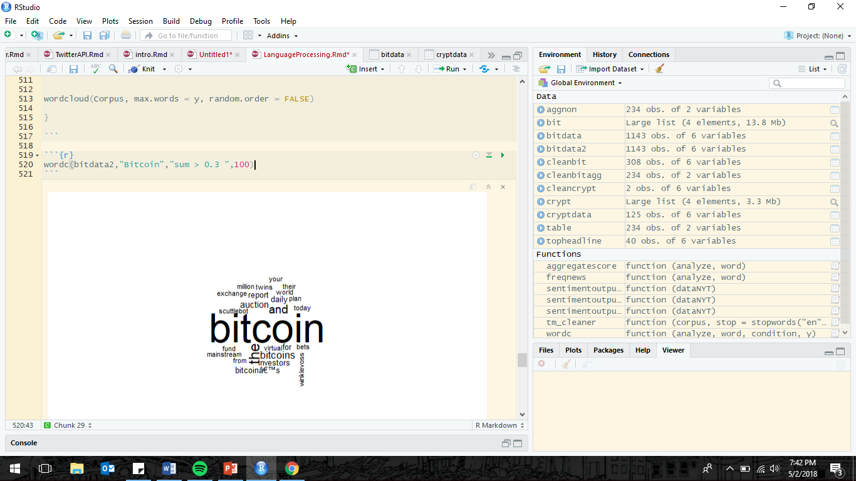
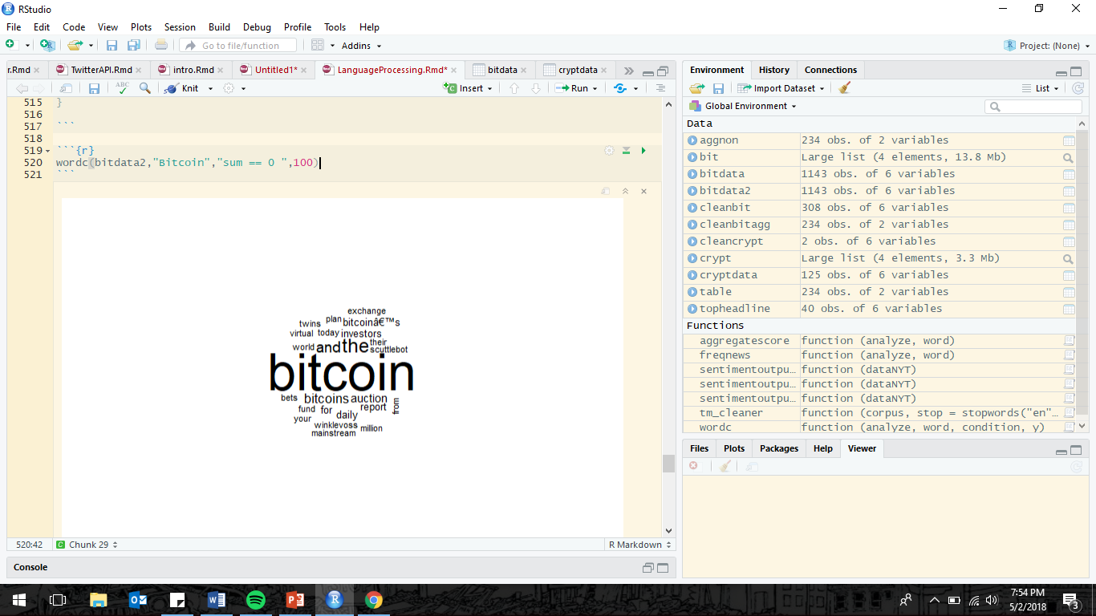
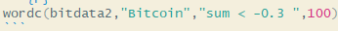

Slide 36

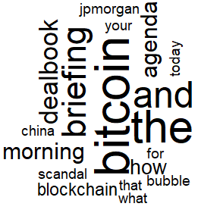
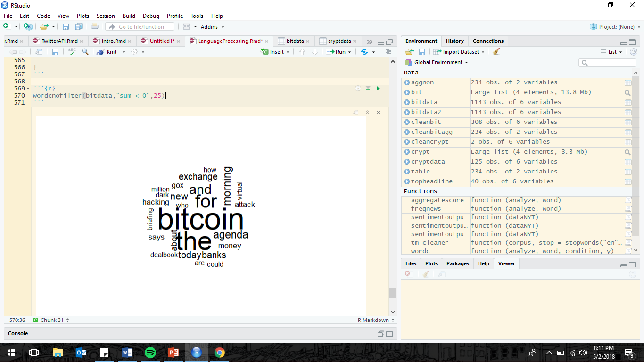
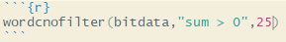
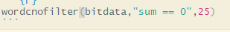

Slide 37

Hypothesis Three: Are mentions of bitcoin by the public related to market value of bitcoin?
What particular events have impacted bitcoin, is a certain type of event on the minds of those who follow bitcoin?

Slide 38
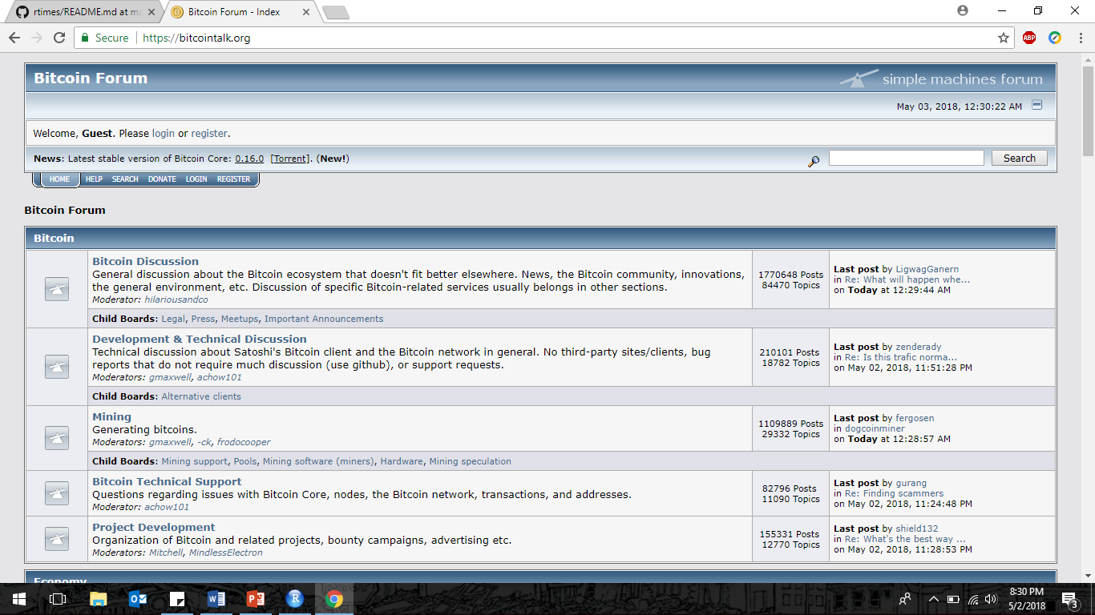

Slide 39
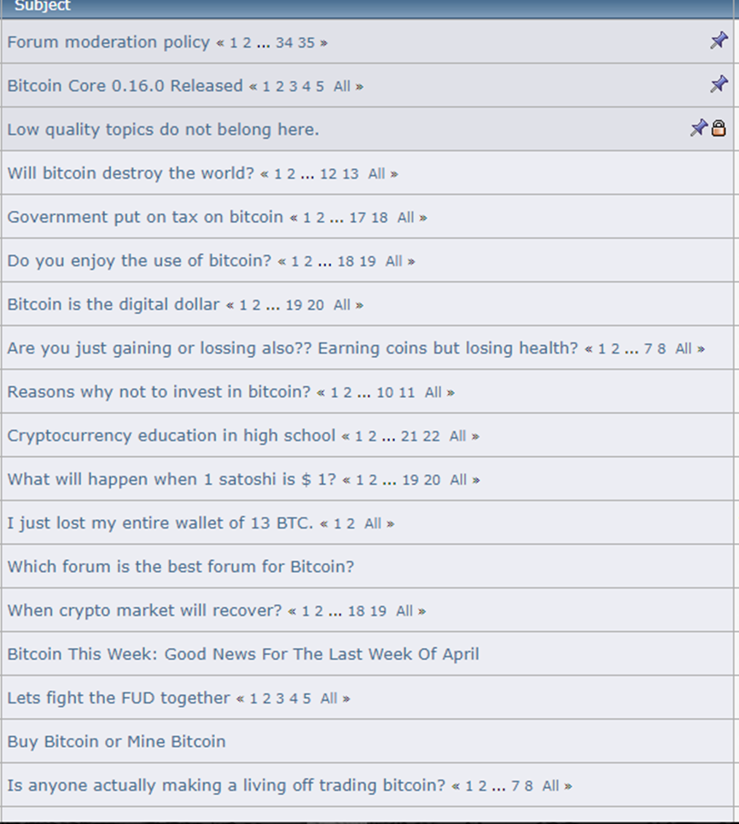

Slide 40
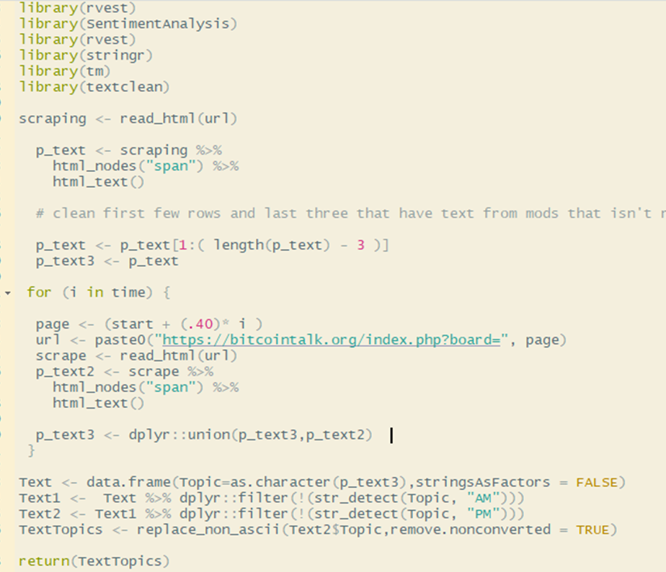
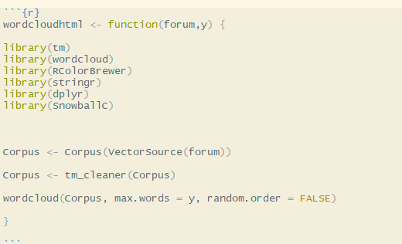

Slide 41
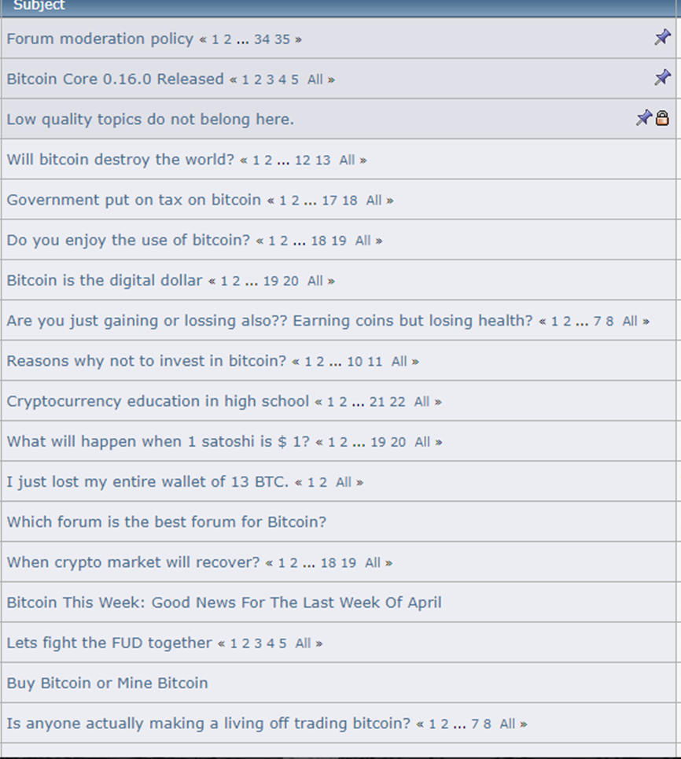
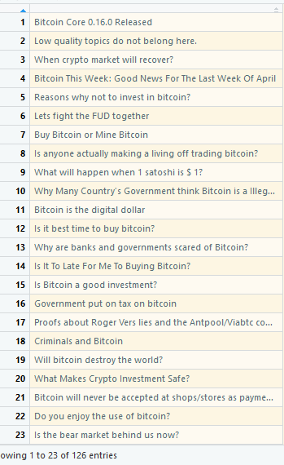

Slide 42
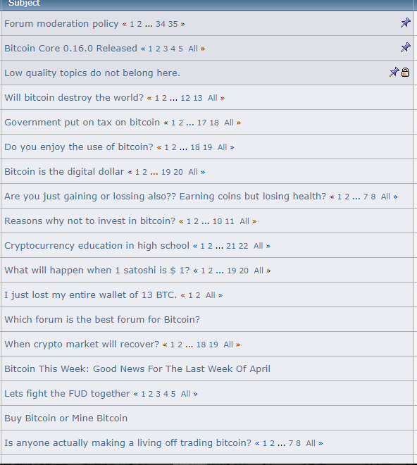


Slide 43
Scraped the following subforums:
BitcoinDiscussion
Economics
Marketplace
Speculation
Altcoin

Slide 44
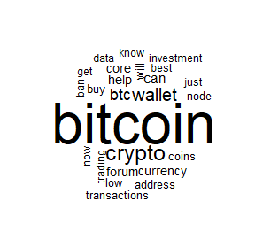


Bitcoindiscussion
Marketplace
Economics

Slide 45
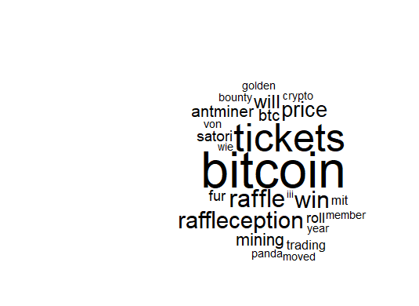
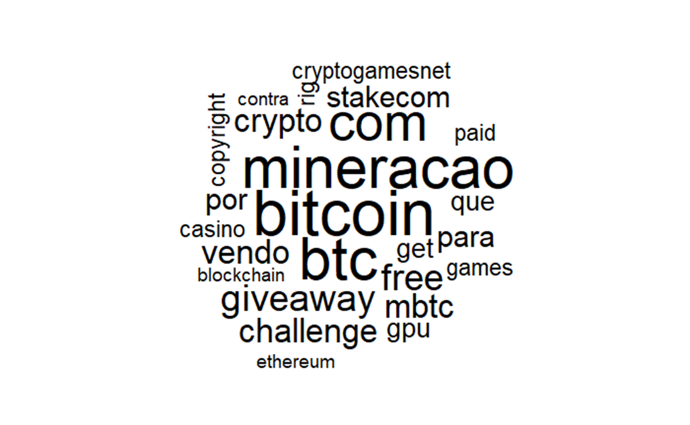
Speculation
Altcoin

Slide 46
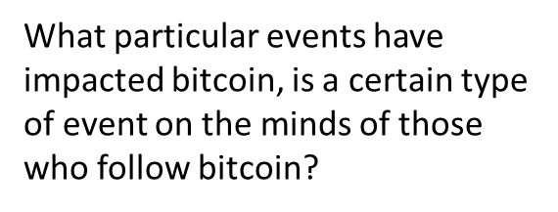




Fraud/Scams
Seeking Financial Advice
Banking organizations response to Cryptocurrencies

Slide 47
Decide to revisit Rtweets…
Given the large diversity of news that people on bitcoin forums discuss, I decide to change my approach.
I had been looking to pinpoint influential events that affected bitcoin, hence the focus on CNN/NYT.
However I decided to use sentiment analysis on news sources that covered cryptocurrencies exclusively

Slide 48





Cryptocurrency news sites
Coindesk.com
Cointelegraph.com
The Merkle
CCN (CryptoCurrency News)
Bitcoin News

Slide 49






Slide 50
Hypothesis Three: Are mentions of bitcoin by the public related to market value of bitcoin?
What particular events have impacted bitcoin, is a certain type of event on the minds of those who follow bitcoin?

Slide 51


Slide 52


Slide 53


Slide 54


Slide 55


Slide 56

Hypothesis One: Are the local peaks of these top cryptocurrencies similar in any way?
From

Slide 57


Slide 58




Slide 59

Notes:
stlplot("Bitcoin",2014,1,2018,112) – bitcoin vaule

Slide 60

Notes:
Seasonal component of bitcoin value

Slide 61

Notes:
Stl plot from bitcoin transactions per day

